Slide 1
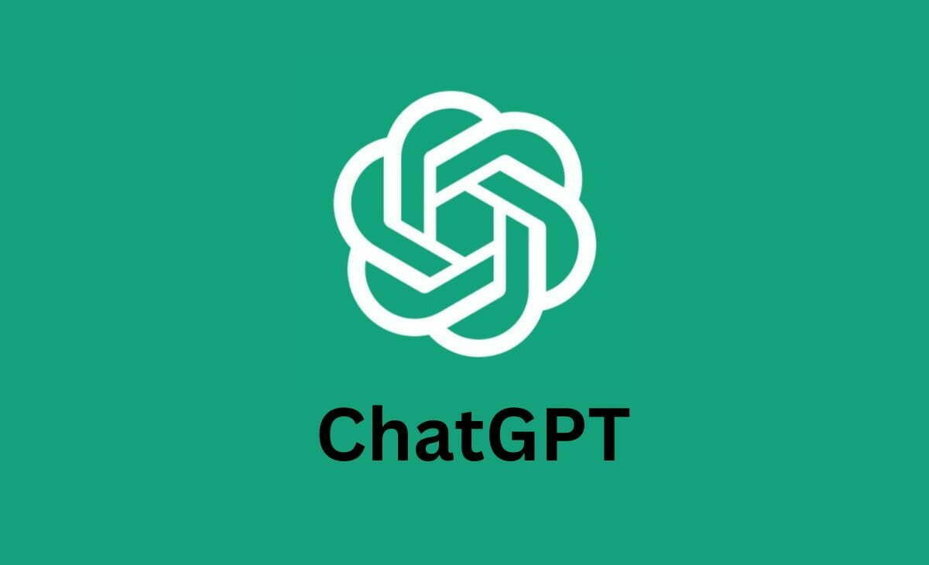

Slide 2
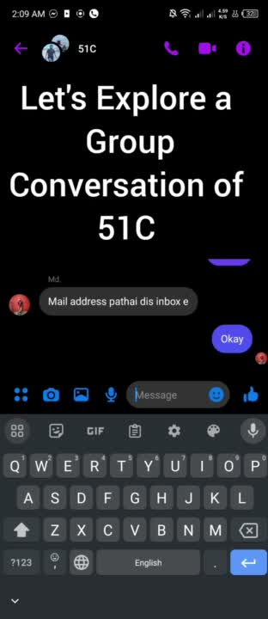

Slide 3

World University of Bangladesh
Presentation on
CHAT GPT
Data Warehouse and Data Mining (CSE-1011)

Slide 4
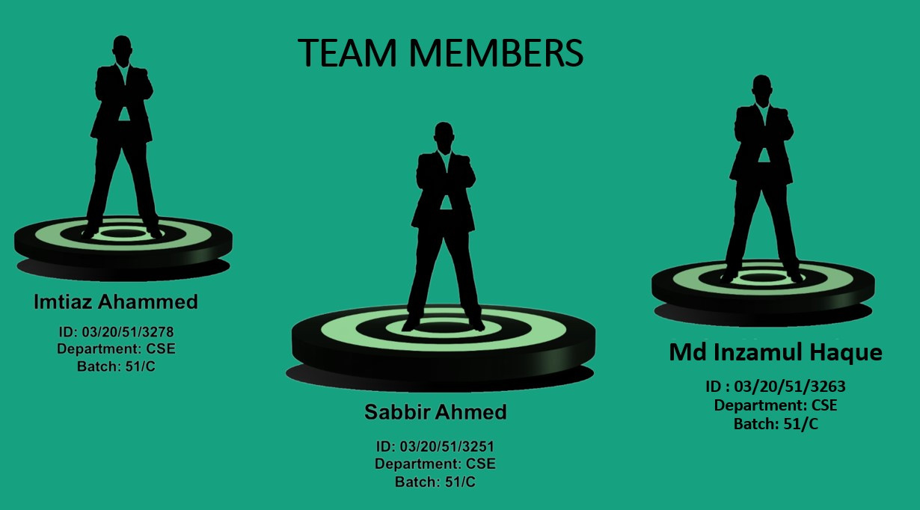

Slide 5
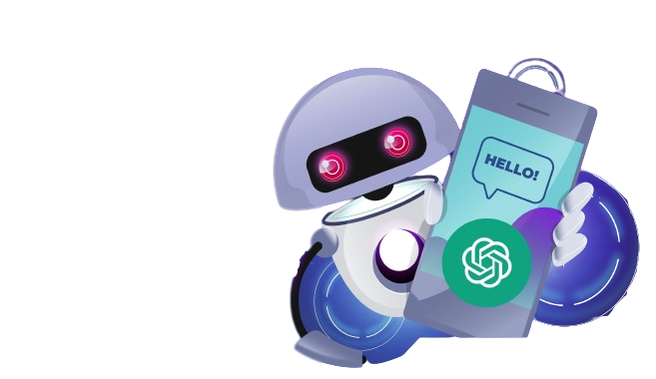
Introduction
Agenda
How Chat GPT Works
Why Chat GPT
Advantages
Disadvantages
Conclusion

Slide 6
What is CHAT GPT?
Chat GPT is an advanced language model based on the GPT-3.5
architecture.
It is an AI-driven conversational interface developed by
OPEN-AI.
The future vision is to integrate Chat GPT as an indispensable tool in various domains, augmenting human capabilities and problem-solving.

Slide 7
How Chat GPT Works?
Transformer Architecture
ChatGPT is built upon the transformer
architecture, which was introduced in
the seminal paper "Attention is All You
Need" by Vaswani et al. in 2017.
2. Attention Mechanism
The heart of the transformer
architecture lies in its attention
mechanism, enabling the model to
weigh the importance of different words
in a sentence concerning each other.

Slide 8
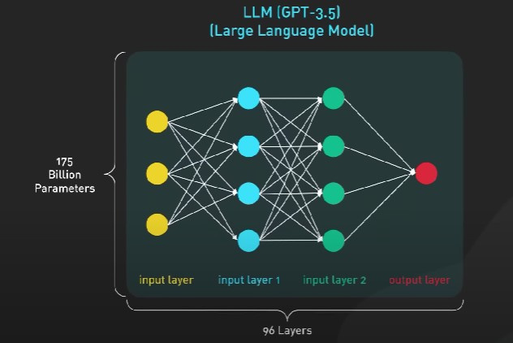
GPT-3.5 Architecture
GPT-3.5 is an advanced
version of the GPT series,
boasting even more
parameters and enhanced performance compared to its
predecessors.

Slide 9
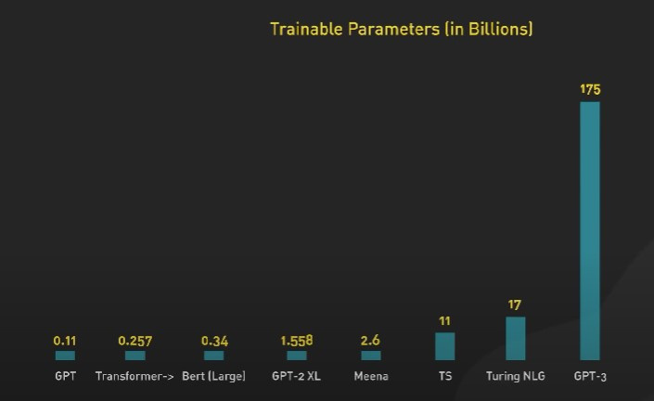
PARAMETERS
GPT-3.5 contains an immense number of parameters, often in the order of billions. These parameters enable the model to learn complex patterns and relationships in the data it is trained on.

Slide 10
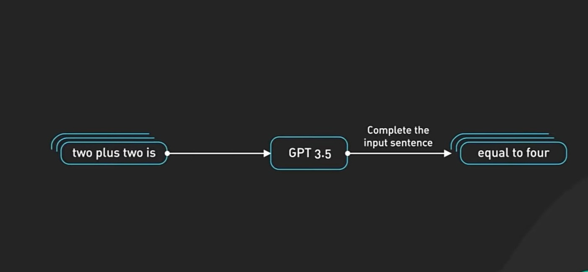
Large Language Model ( LLM )

Slide 11
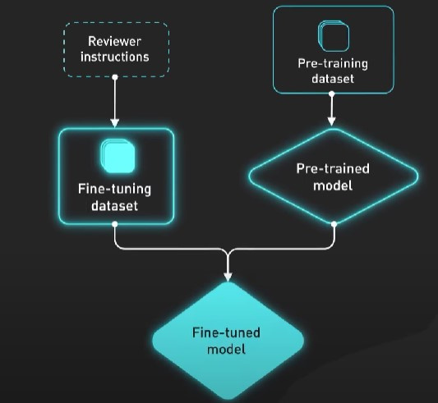
FINE TUNED MODEL
Pre-training and Fine-tuning
Like other language models,
ChatGPT undergoes a two-step
process:
1. pre- training
2. fine-tuning

Slide 12
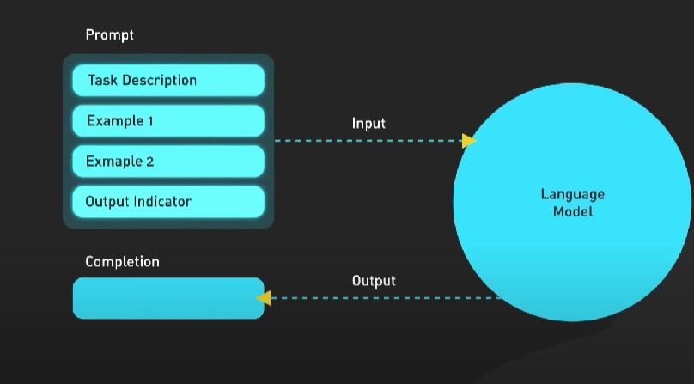
PROMT ENGINEERING
The way prompts are designed and given to the model plays a crucial role in its responses.

Slide 13
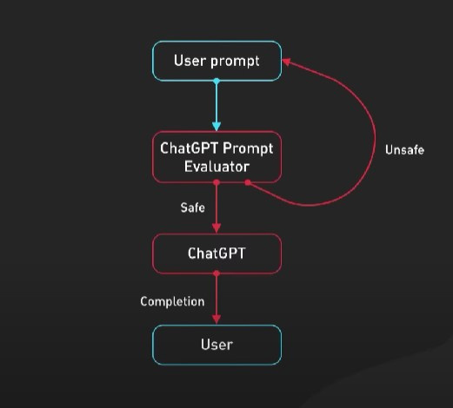
Context Sensitivity
The architecture is designed to be context-sensitive, which allows ChatGPT to consider the preceding conversation or prompt to generate coherent and relevant responses.

Slide 14
WHY CHAT GPT??
Natural Language Understanding
ChatGPT is designed to understand and generate human-like text, making it well-suited for chatbot applications, conversational interfaces, and text generation tasks.
Few-shot and Zero-shot Learning
ChatGPT can perform tasks with minimal examples (few-shot) or even no examples (zero-shot), which makes it more accessible and easier to implement for certain applications compared to models that require large amounts of task-specific training data.

Slide 15
WHY CHAT GPT??
Versatility
The versatility of Chat GPT is truly awe-inspiring. It rises to the occasion, whether it be answering straightforward queries or engaging in thought-provoking debates.
Continuous Learning
The model's ability to undergo fine-tuning allows it to continuously learn from real-world interactions, refining its responses and growing more adept with each encounter.

Slide 16
What makes it different from Siri or Alexa?
In ChatGPT, two competing neural networks –
A Generator
A Discriminator
work in competition to generate realistic-looking outputs.
As the Generator creates fake outputs, the Discriminator determines whether the outputs are real or fake. Through this back-and-forth process, the GAN (Generative Adversarial Network) can produce outputs that are indistinguishable from real-world data.

Slide 17
What makes it different from Siri or Alexa?
ChatGPT's use of GANs enables it to engage in human-like conversations and provide imaginative responses that a human might not be able to type out.
2. For example, if asked about becoming invisible, ChatGPT
might reply with an imaginative response involving
technologies like cloaking devices that use metamaterials to
bend light and achieve invisibility from certain angles.

Slide 18
ADVANTAGES
Human-like Conversations
Chat GPT's architecture excels at generating human-like responses, mimicking natural conversation flow and evoking a sense of familiarity and connection in users.
Efficient Virtual Assistants
GPT can effectively function as virtual assistants, efficiently handling tasks like appointment scheduling and providing prompt responses to user inquiries.

Slide 19
DISADVANTAGES
Resource Intensive
Implementing and deploying Chat GPT can be resource-intensive, demanding substantial computational power and potentially limiting access for some organizations.
Potential for Bias
The risk of generating biased or inappropriate responses arises when GPT is trained on biased data or used inappropriately, making careful curation and moderation crucial in its application.

Slide 20
DISADVANTAGES
Ethical Considerations
As with any powerful AI tool, Chat GPT raises ethical concerns surrounding misinformation, deepfakes, and potential biases encoded within its vast training data.
Contextual Limitations
While Chat GPT shines in most scenarios, it may face challenges with understanding complex, ambiguous, or contextually nuanced queries, leading to occasional inaccuracies.

Slide 21
CONCLUSION
Chat GPT represents a remarkable step forward in natural
language processing and AI-driven conversational interfaces.
It showcases the power of the GPT-3.5 architecture, demonstrating AI's potential to revolutionize human-computer interactions.
The technology has the capacity to transform how we interact with technology, making it more intuitive and user-friendly.
Ethical concerns must be addressed as we move forward to ensure responsible AI development.

Slide 22
CONCLUSION
Continuous refinement of Chat GPT is essential to enhance
accuracy, reliability, and context-awareness in responses.
The goal is to create a user-centric AI experience that aligns with ethical guidelines and avoids perpetuating biases or spreading misinformation
The future vision is to make AI an indispensable tool in our daily lives, helping us solve complex problems and augment human capabilities across various domains.

Slide 23


THANK YOU
ANY QUESTIONS?

